Slide 1
Unit 9 Assignment
Desmond Hughes
SS290 Data in Our World - Introduction to Data Literacy
11/21/2022
Christopher Guido

Slide 2
Introduction to Data Visualization
It is graphical representation of data and information
Helps with better understanding of information
Good use to get an accurate analysis and trends

Slide 3
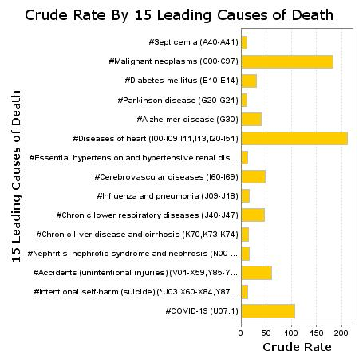
Notes:
About the Image:
In-text APA citation for the visualization
(2021, March 18).
Why did you choose this visualization? Because it interested me in the different diseases and other issues going on that are responsible for death.
Is it ADA compliant? Yes
What does it tell you about the data that it is portraying? The leading causes of death
What method does it use? (if you can identify the chart) Bar Graph
How else could you produce a visualization for this data type? Line Chart

Slide 4
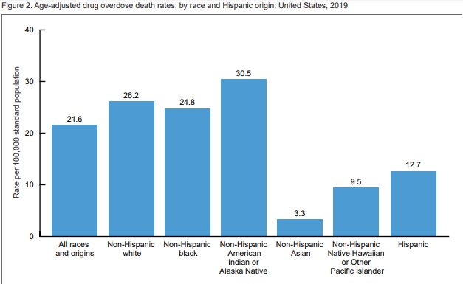
Notes:
About the Image:
In-text APA citation for the visualization (2021, March 18).
Why did you choose this visualization? I picked this graph because I had a friend that overdosed and was interested in the statistic
Is it ADA compliant? No
What does it tell you about the data that it is portraying? The leading races with drug overdose rate
What method does it use? (if you can identify the chart) Bar Graph
How else could you produce a visualization for this data type? Scatter graph

Slide 5
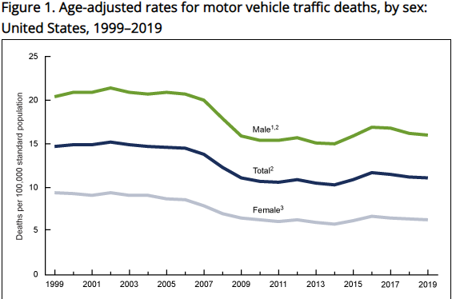
Notes:
About the Image:
In-text APA citation for the visualization (2021, March 18).
Why did you choose this visualization? It interested me and I wanted to keep the same theme of issues that causes death
Is it ADA compliant? No
What does it tell you about the data that it is portraying? Motor Vehicle Death by Gender
What method does it use? (if you can identify the chart)Line Chart
How else could you produce a visualization for this data type? Stacked Bar Graph

Slide 6
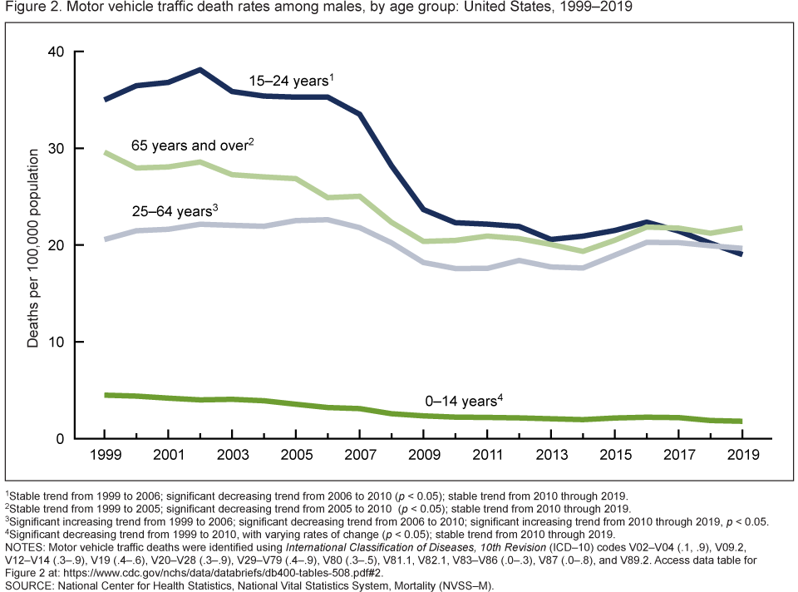
Notes:
About the Image:
In-text APA citation for the visualization (2021, March 18).
Why did you choose this visualization? It interested me and I wanted to keep the same theme of issues that causes death
Is it ADA compliant? No
What does it tell you about the data that it is portraying? Motor Vehicle Death by Age in Males
What method does it use? (if you can identify the chart) Line Chart
How else could you produce a visualization for this data type? Comparison Chart

Slide 7
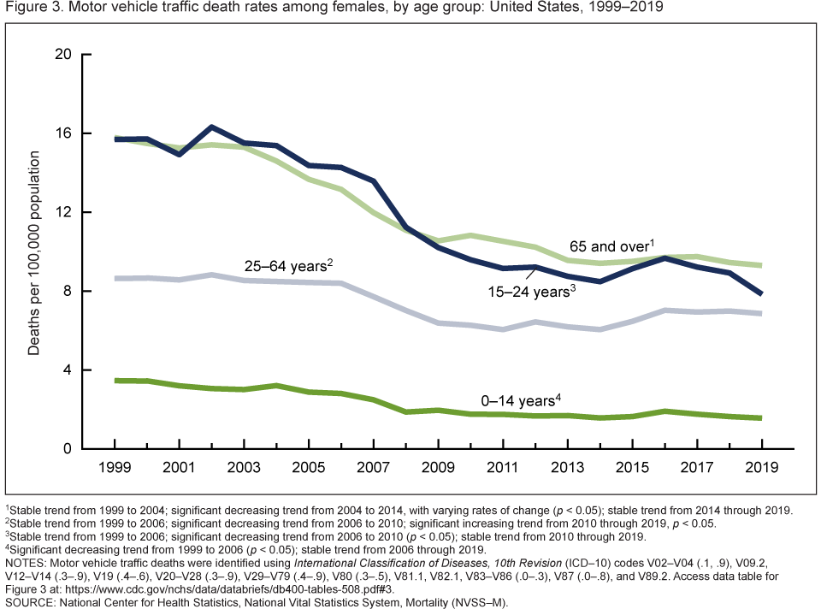
Notes:
About the Image:
In-text APA citation for the visualization (2021, March 18).
Why did you choose this visualization? It interested me and I wanted to keep the same theme of issues that causes death
Is it ADA compliant? No
What does it tell you about the data that it is portraying? Motor Vehicle Death by Age in Women
What method does it use? (if you can identify the chart) Line Chart
How else could you produce a visualization for this data type? Comparison Chart

Slide 8
Summary
15 Leading Causes of Death
Overdose Rate by Race
Motor Vehicle Death by Gender
Motor Vehicle Death by Age in Males
Motor Vehicle Death by Age in Women

Slide 9
References
Centers for Disease Control and Prevention. (n.d.). CDC wonder. Centers for Disease Control and Prevention. Retrieved November 22, 2022, from https://wonder.cdc.gov/
Centers for Disease Control and Prevention. (2021, March 23). Products - health e stats - drug poisoning mortality, by state and by Race and ethnicity: United States, 2019. Centers for Disease Control and Prevention. Retrieved November 22, 2022, from https://www.cdc.gov/nchs/data/hestat/drug_poisoning_mortality/drug-poisoinging-mortality.htm
Centers for Disease Control and Prevention. (2021, March 18). Motor Vehicle Traffic Death Rates, by Sex, Age Group, and Road User Type: United States, 1999–2019. Centers for Disease Control and Prevention. Retrieved November 22, 2022, from https://www.cdc.gov/nchs/products/databriefs/db400.htm

